Slide 1
DETERMINATION OF PARKINSON’S DISEASE
Presented by:
Name: Vamshi Nadigottu
Branch: Computer Science And Engineering
Year:2020-2024

Slide 2
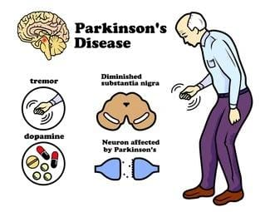
DETECTING PARKINSONS DISEASE USING MACHINE LEARNING

Slide 3
Introduction
According to Parkinson’s foundation more than 10 million people in the world are living with Parkinson Disease
Parkinson’s disease cannot be cured but early detection along with proper medication can significantly improve symptoms and quality of life .
There searchers found that the drawing speed was lower and the pen pressure is lower among Parkinson’s patients.
One of the indications of Parkinson’s is tremors and rigidity in the muscles, making it difficult to draw smooth spiral sand waves.
It is possible to detect Parkinson’s disease using the drawings alone instead of measuring the speed and pressure of the pen on paper.
In this project, We are using, Forest classifier to automatically detect Parkinson’s disease in hand-drawn images of spirals and waves.

Slide 4
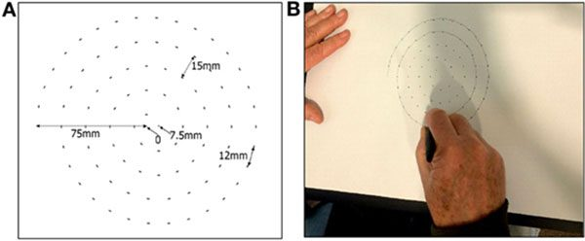
literature
A research paper in 2017 by Zham et al explained how to detect parkinson disease without doing any MRI scans on the brain just by detecting the speed and pen presuure of sketching a spiral or a wave.

Slide 5
Objectives
By this we can detect the parkinson’s disease by scanning the pattern of the patient

Slide 6
Contents
What is random forest algorithm
Working of Random forest algorithm
Architecture diagram
Flow chart
conclusion

Slide 7
What is Random Forest algorithm
Random forest is a classifier that contains several decision trees on various subsets of a given dataset and takes the average to enhance the predicted accuracy of that data set.
Instead of depending on decision tree random forest collect the result from each tree and expect the majority output.
Random forest algorithm uses supervised learning methods.
It can perform both regression and classification tasks.
It handles large data sets efficiently.
Random forest algorithm provides a high level of accuracy.

Slide 8
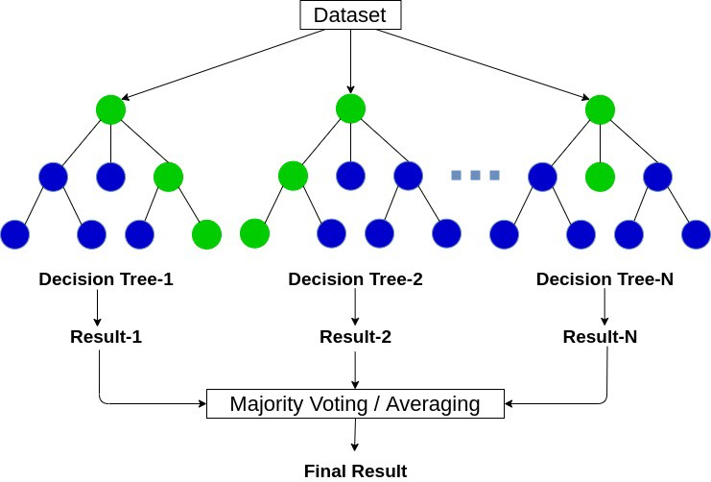
Working of random forest algorithm

Slide 9
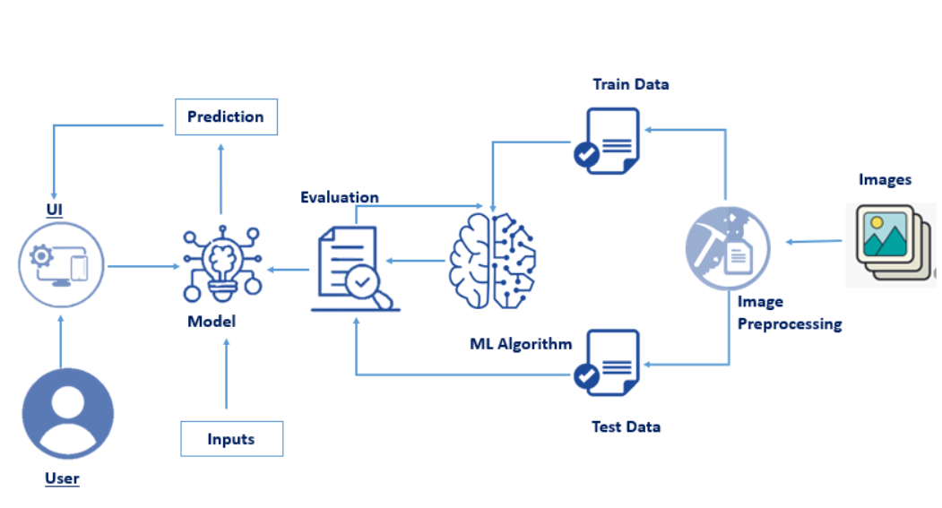
Architecture diagram:

Slide 10
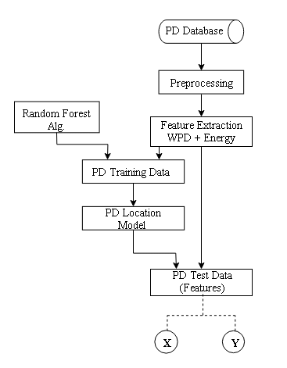
Flow Chart:
This flow chart shows the starting and ending process of patients of parkinson’s disease and preprocessing of data is required in this project mean and median filter are presented for selecting images & we used Randam forest classifier for training and testing the data.

Slide 11
Conclusion:
With the discovery of dopamine in the twentieth century and the subsequent development of dopamine replacement therapy, plus surgical techniques such as deep brain stimulation (DBS), many of the debilitating symptoms are now successfully treated—at least for a time.
Despite the increased attention on Parkinson’s, there is still no diagnostic test that is definitive.
Based on pen pressure and drawing speed we can able to detect whether the person is having parkinson’s disease or not.
The person who is suffering from this disease their drawing speed was slow and the pen pressure is also slow.

Slide 12


